Slide 1

The Magical World of Data

Slide 2


Hello! I’m Mary Welsh
About me
Data Engineer at Adobe
Adobe Lehi Women in Tech Club Lead
Worked in tech for over 15 years
BS Mathematics, Computer Science Minor from UVU, 2012
Data/database nerd
Husband, one 19-month-old daughter, 2 lab mix dogs

Slide 3
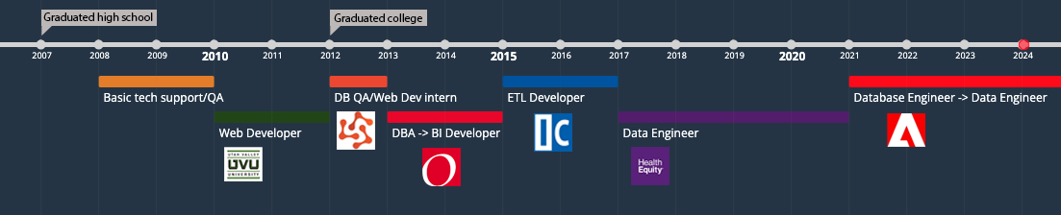
My Career Path Timeline

Slide 4
Web Developer
Front End/Back End
What I did
Created, updated, maintained, and documented various university departments' web applications and websites
Skills used/learned
HTML
CSS
PHP
JavaScript
MySQL
Various frameworks (jQuery, Symfony, Zend)
What I enjoyed about it
Visual aspect of web development, especially front end
Databases!
Dislikes
PHP
Frameworks were confusing and clunky
Salary range: $40k – $120k
Utah average: $70k

Slide 5
Database Engineer (DBE)
AKA: Database Administrator (DBA)
What I did
Administered database environments for their respective users
Reviewed, optimized, tested, and deployed database scripts and updates
Developed internal applications and automations to facilitate everyday DBA tasks and report essential metrics
Periodically provided on-call database support and maintenance after normal business hours
Skills used/learned
SQL (MS SQL, Oracle)
MongoDB
Python
AWS console for RDS
Oracle consoles
What I enjoyed about it
Automation for making tedious tasks easy
SQL query optimization
Dislikes
On call rotations
Businesses depend on their databases being up and working: more pressure
Simple tasks got repetitive and boring
Salary range: $60k – $130k
Utah average: $110k

Slide 6
Data Analyst
AKA: BI Developer
What I did
Wrote ad-hoc queries against the data warehouse to provide greater business insight for several teams
Compiled key reports and metrics into dashboards and visualizations
Automated several intricate manual Excel report processes
Skills used/learned
SQL
Excel - VBA
Visualization software, e.g. SSRS, Tableau, Visual Insights, Microstrategy, PowerBI
What I enjoyed about it
Complex querying
Data visualizations
Dashboard automations
Dislikes
Not enough coding for me
More customer facing products
Salary range: $60k – $100k
Utah average: $70k

Slide 7
Data Engineer (Currently)
AKA: ETL Developer
What I did/do
Developed database architecture of new data warehouse
Migrated and optimized old objects and reports into the new data warehouse
Create new database objects/processes to combine data from multiple sources to give greater business insight
Skills used/learned
SQL
Python
AWS – RDS, Redshift
MariaDb
MySQL
Airflow
SSIS
What I enjoy about it
Creating data pipelines
Combining data from all over
Using cloud technologies
Dislikes
Troubleshooting broken things (especially when they’re mine)
Tribal knowledge learning curve
Salary range: $85k – $200k
Utah average: $100k

Slide 8
Other Related Careers in Data
Data Scientist
Data science is an interdisciplinary academic field that uses statistics, scientific computing, scientific methods, processes, algorithms and systems to extract or extrapolate knowledge and insights from noisy, structured, and unstructured data.
AI Engineer
The Artificial Intelligence Engineer is an IT expert whose mission is to develop intelligent algorithms capable of learning, analyzing and predicting future events. Their role is to create machines capable of reasoning like the human brain.
Architect
Responsibilities include designing the structure of new technology systems and overseeing program implementation. Tech architects work alongside enterprise architects and other IT roles to deliver technical solutions while managing large teams of developers and IT specialists.
Salaries upwards of $200k
Also: Management, Security, Product/Project Manager

Slide 9
How to Get Into a Data Career
College degrees: STEM fields preferable but not necessary
Certificates:
SAS Certified Data Scientist
Certified Analytics Professional (CAP)
Data Science Council of America (DASCA) Principal Data Scientist (PDS)
IBM Data Science Professional Certificate
Microsoft Certified: Azure AI Fundamentals
Microsoft Certified: Azure Data Scientist Associate
Amazon Web Services (AWS) Certified Data Analytics – Specialty
Data Science Council of America (DASCA) Senior Big Data Engineer
Google Professional Data Engineer
SAS Certified Data Integration Developer
Online learning resources/bootcamps:
Youtube
Pluralsight
Datacamp
SQLBolt
Kaggle
Cloudacademy.com
AWS/Azure/GCP cloud training resources
Free play - Github
NETWORKING! Look for mentors/advocates
More info: https://www.bls.gov/ooh/computer-and-information-technology/home.htm

Slide 10
Thank you!
Questions?

